Slide 1
Software engineering
Section 1

Slide 2
Importance of software
Software can have a huge impact in any aspect of society.

Slide 3


Where can you find software?

Slide 4
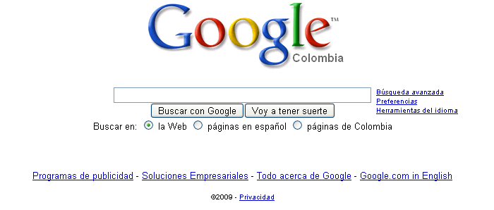


Some popular ones…

Slide 5


And even in…

Slide 6
Software is Almost Everywhere.

Slide 7
Problems in software development

Slide 8
Common issues
The final Software doesn´t fulfill the needs of the customer.
Hard to extend and improve: if you want to add a functionality later is mission impossible.
Bad documentation.
Bad quality: frequent errors, hard to use, ...
More time and costs than expected

Slide 9
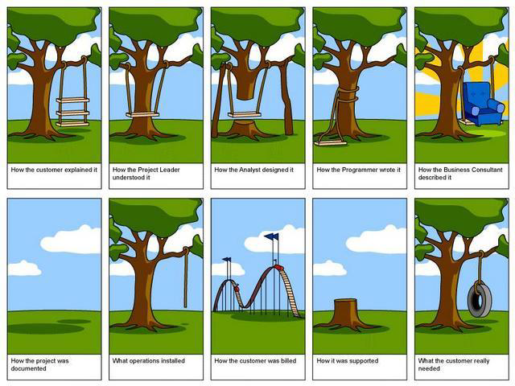

Slide 10
Wrong!
But
That never
happens,
right?

Slide 11
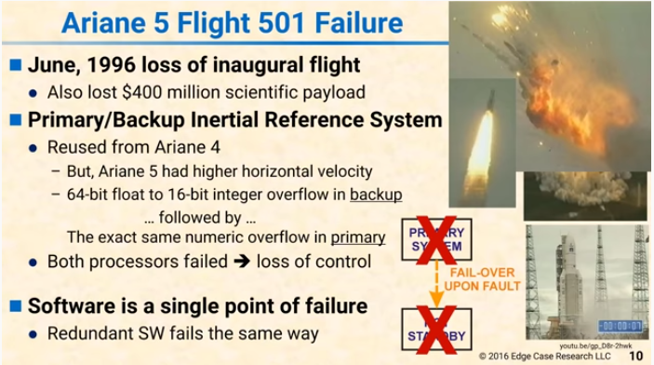
Ariane 5 Flight 501

Slide 12
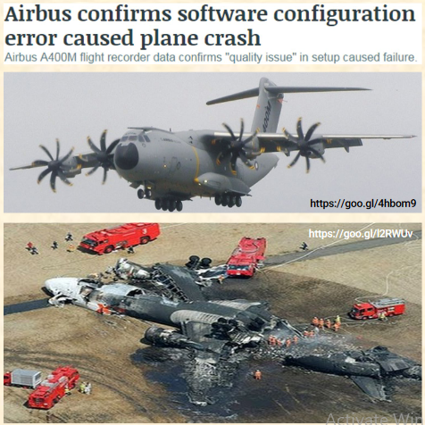

Slide 13
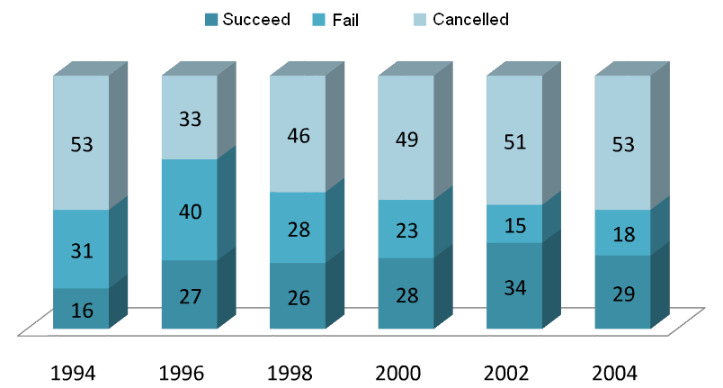
Chaos Report

Slide 14
Conclusion
Programming is NOT enough!
It is not enough to do your best: you must know what to do, and THEN do your best.
-- W. Edwards Deming

Slide 15
Solution

Slide 16
Software Engineering
The application of a systematic, disciplined, quantifiable approach to the development, operation, and maintenance of software, and the study of these approaches; that is, the application of engineering to software.
The study and application of methodologies to develop quality software that fulfill customer needs.

Slide 17
Software Engineering
Objective
To produce software that is:
On time: is deliver at the established date.
Reliable: doesn´t crash.
Complete: good documentation, fulfill customer needs.

Slide 18
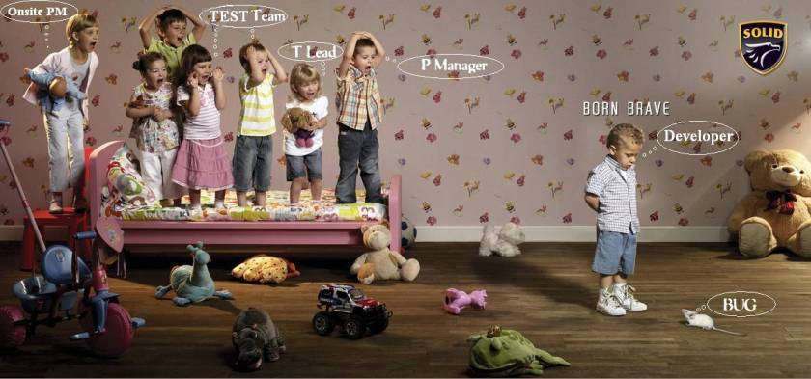
The team

Slide 19
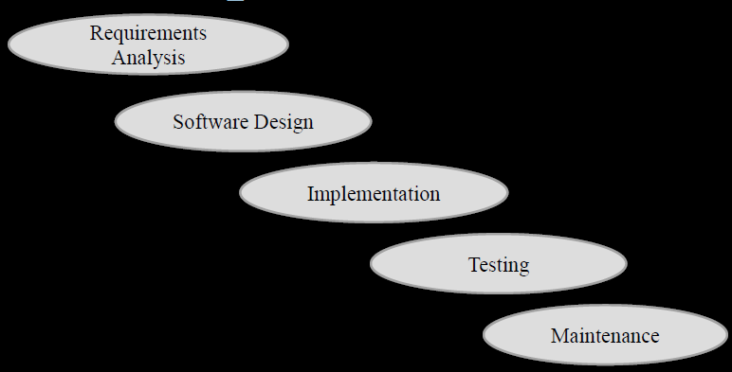
Stages for software development

Slide 20
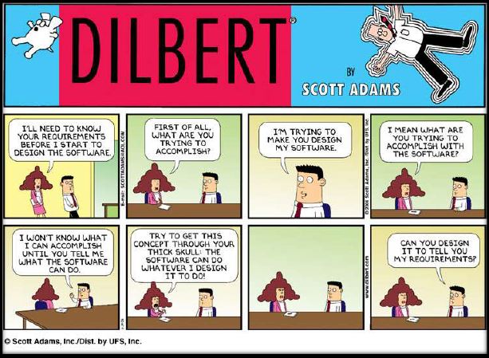
Requirements Analysis
Find out what the client want the software to do

Slide 21
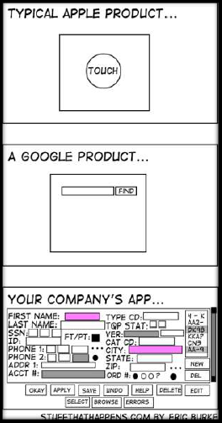
Design
Planning the software solution

Slide 22
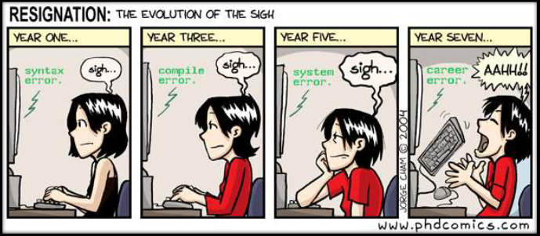
Implementation
Code!!

Slide 23
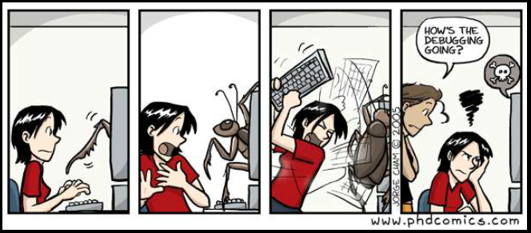
Testing
Executing the application trying to find software bugs

Slide 24
Maintenance
Any activity oriented to change an existing software product

Slide 25
Process Models

Slide 26
Process Models
Waterfall model
Incremental model
Prototyping
Spiral model

Slide 27
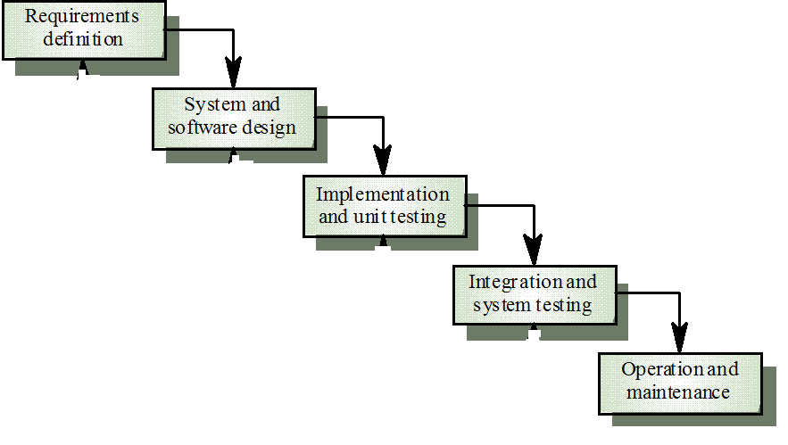
The waterfall model

Slide 28
The waterfall model
When to use?
The requirements are well defined and reasonably stable.
The requirements are fixed
The work proceed to completion in a linear manner.

Slide 29
The waterfall model
Problems
Iterations can be accommodated which cause confusion as the project team proceeds.
It is often difficult for the customer to state all requirements explicitly.
The customer must have patience. A working version of the program(s) will not be available until late in the project time span.
the linear nature of the classic life cycle leads to “blocking states” in which some project team members must wait for other members of the team to complete dependent tasks.

Slide 30
The waterfall model
Problems
Inflexible partitioning of the project into distinct stages.
This makes it difficult to respond to changing customer requirements
Therefore, this model is only appropriate when the requirements are well-understood

Slide 31
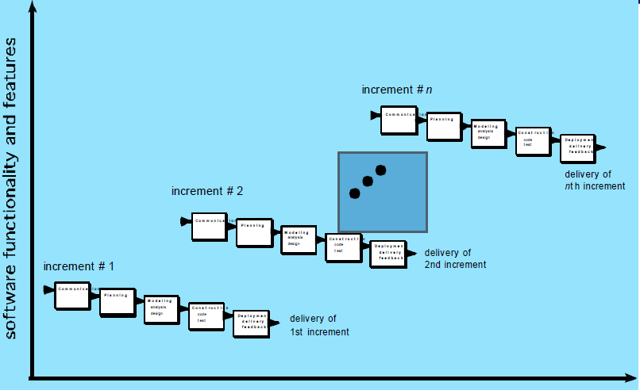
The Incremental model

Slide 32
The Incremental model
The incremental model delivers a series of releases, called increments, that provide progressively more functionality for the customer as each increment is delivered

Slide 33
The Incremental model
When to use?
The initial software requirements are well defined, but the overall scope of the development is unclear.
There may be a compelling need to provide a limited set of software functionality to users quickly and then refine and expand on that functionality in later software releases

Slide 34
The Incremental model
why to use?
Your customer demands delivery by a date that is impossible to meet. Suggest delivering one or more increments by that date and the rest of the software later.
Manage technical risks(Ex: major system might require the availability of new hardware that is under development, plan early increments in a way that avoids the use of this hardware, enabling partial functionality to be delivered to end users without inordinate delay).

Slide 35
The Incremental model
Advantages
Customer value can be delivered with each increment so system functionality is available earlier
Early increments act as a prototype to help elicit requirements for later increments
Lower risk of overall project failure
The highest priority system services tend to receive the most testing

Slide 36
Evolutionary process model
Prototyping
Spiral model

Slide 37
Evolutionary process Models
When to use?
Business and product requirements often change as development proceeds, making a straight line path to an end product unrealistic
Evolutionary process models produce an increasingly more complete version of the software with each iteration.

Slide 38
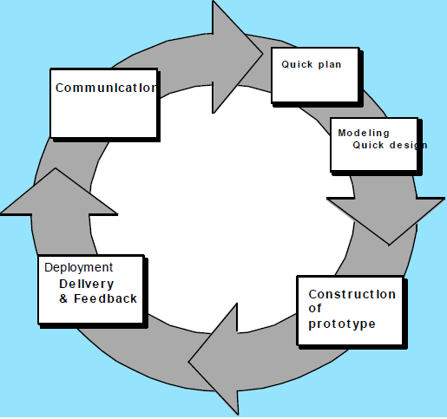
Prototyping

Slide 39
Prototyping
When to use?
customer defines a set of general objectives for software, but does not identify detailed requirements for functions and features.
the prototyping paradigm assists you and other stakeholders to better understand what is to be built when requirements are fuzzy.
prototyping can be used as a stand-alone process model, it is more commonly used as a technique that can be implemented within the context of any one of the process models

Slide 40
Prototyping
When to use?
Serves as a mechanism for identifying software requirements.
Build a pilot system and throw it away.

Slide 41
Problems of prototyping model
Stakeholders see what appears to be a working version of the software, unaware that the prototype is held together haphazardly, unaware that in the rush to get it working you haven’t considered overall software quality or long-term maintainability. When informed that the product must be rebuilt so that high levels of quality can be maintained, stakeholders cry foul and demand that “a few fixes” be applied to make the prototype a working product. Too often, software development management relents.
As a software engineer, you often make implementation compromises in order to get a prototype working quickly. An inappropriate operating system or programming language may be used simply because it is available and known; an inefficient algorithm may be implemented simply to demonstrate capability. After a time, you may become comfortable with these choices and forget all the reasons why they were inappropriate. The less-than-ideal choice has now become an integral part of the system.

Slide 42
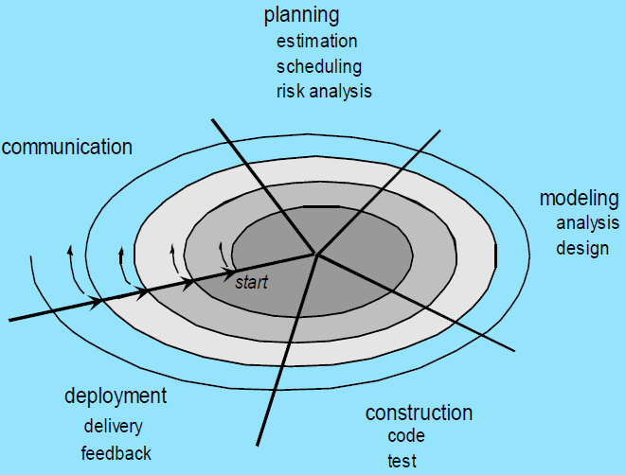
The Spiral Model

Slide 43
The Spiral Model
Combines the waterfall model with the prototype model.
Each phase in spiral model begins with a design goal and ends with the client reviewing the progress.
starts with a small set of requirement and goes through each development phase for those set of requirements. Then adds functionality for the additional requirement in every-increasing spirals until the application is ready for the production phase.

Slide 44
The Spiral Model
Each loop in the spiral represents a phase in the process.
No fixed phases such as specification or design -loops in the spiral are chosen depending on what is required
Risks are explicitly assessed and resolved throughout the process

Slide 45
The Spiral Model
When to use
project is large
releases are required to be frequent
creation of a prototype is applicable
risk and costs evaluation is important
For medium to high-risk projects
requirements are unclear and complex
changes may require at any time
long term project commitment is not feasible due to changes in economic priorities

Slide 46
Advantages of spiral model
Additional functionality or changes can be done at a later stage
Cost estimation becomes easy as the prototype building is done in small fragments
Continuous or repeated development helps in risk management
Development is fast and features are added in a systematic way
There is always a space for customer feedback

Slide 47
Disadvantages of spiral model
Risk of not meeting the schedule or budget
It works best for large projects only also demands risk assessment expertise
For its smooth operation spiral model protocol needs to be followed strictly
Documentation is more as it has intermediate phases
It is not advisable for smaller project, it might cost them a lot

Slide 48
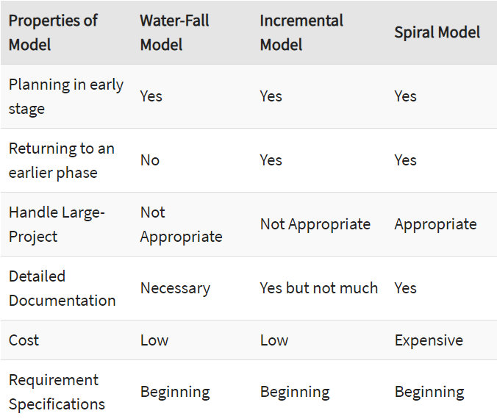

Slide 49

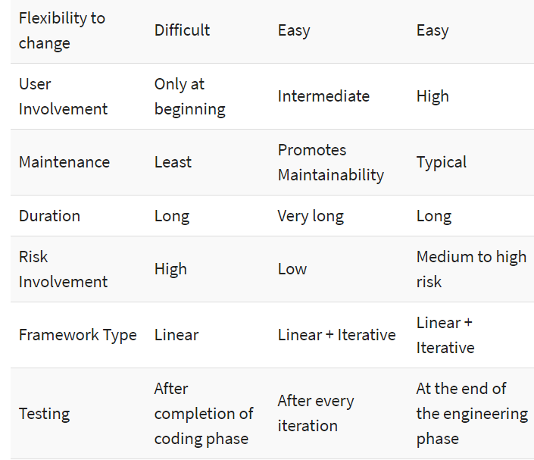

Slide 50
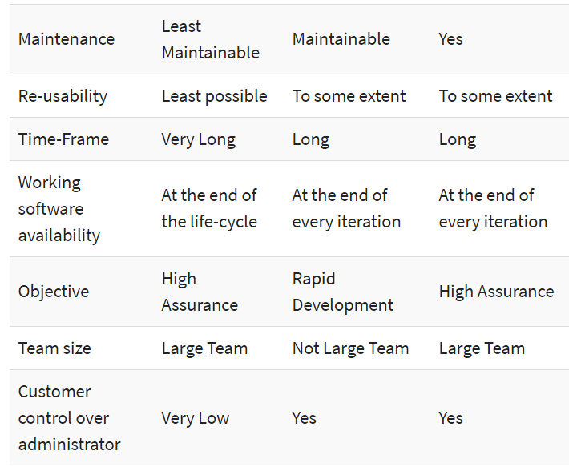

Slide 51
Sheet 1

Slide 52
1. Three examples of software projects that would become amenable to the waterfall model
An Operating System, as the various specific parts of the OS could be developed as the user requires them.
A Graphical User Interface, the GUI can be created according to the customer’s requirements and approval
A Web Application, a base application can be developed and delivered.

Slide 53
2. As a project manager, your task is to select the appropriate process model for a new, highly risky project that will implement the latest compression and encryption technologies, based on mostly informal requirements. Your development team does not yet possess all the technical skills needed to deliver all aspects of the project. What process model would you choose? Why?
incremental model is that it can manage technical risk if the requirement of software is well understood.
It is easier to get customer feedback.

Slide 54
3. Giving reasons for your answer based on the type of system being developed, suggest the most appropriate process model that might be used as a basis for managing the development of the following systems
A system to control anti-lock braking in a car
This is a safety-critical system so requires a lot of up-front analysis before implementation. It certainly needs a plan-driven approach to development with the requirements carefully analyzed. A waterfall model is therefore the most appropriate approach to use.

Slide 55
3. Giving reasons for your answer based on the type of system being developed, suggest the most appropriate process model that might be used as a basis for managing the development of the following systems
A virtual reality system
This is a system where the requirements will change and there will be an extensive user interface components. Incremental model is the most appropriate model.

Slide 56
3. Giving reasons for your answer based on the type of system being developed, suggest the most appropriate process model that might be used as a basis for managing the development of the following systems
An interactive travel planning system
System with a complex user interface but which must be stable and reliable. An incremental model is the most appropriate as the system requirements will change as real user experience with the system is gained.

Slide 57
Example 4
You have been tasked to develop the system for a mine pump control system, designed to monitor and pump flood water out of mine shafts. As underground mining operations take place far below the water table, flooding into mine galleries and shafts is an ever-present danger. Excessive flooding is clearly a safety hazard for workers, but also has profitability implications ranging from equipment damage to productivity delays, to mine closures in extreme circumstances.
The system to be developed will be required to monitor the water level in each mine shaft using two sensors. A high-water sensor that measures the maximum acceptable level of flooding in a shaft before pumping begins, and a low water sensor, which measures the minimum level of acceptable flooding and pumping stops. These sensors are used to start a mine pump. When the flooding level exceeds the level determined by the high-water sensor the pump is switches on. When the water has been pumped out and the minimum level of acceptable flooding has been reached, as measured by the low water sensor, the pump switches off.

Slide 58
Example 4 cont.
In addition to flooding mining is often hindered by methane pockets, where gas seeps into the shafts and galleries triggering an evacuation. Again, this is a safety hazard, the mining staff won’t be able to breathe, and even more critically, operating equipment may generate sparks which will cause the methane to ignite. Therefore, the system will include a methane sensor that will be used to trigger an evacuation alarm in the presence of dangerous levels of methane (measured in N parts per million), and switch off the pump regardless of the current water level.
The system is used by two key roles. The first is the Operator. This role is required to log in to the system with a username and password. Following a successful login, the operator can start or stop the pump if, and only if, the water level is between the high and low sensor limits. The second role is the Supervisor. A supervisor must verify their security credential as per the operator above. Following a successful login, they can switch the pump on, or off at any time. For example, a supervisor could run the pump after the flood level has dropped below the level set by the low water sensor. They could also switch the pump off if the water level goes over the maximum high level of flooding. In these cases, the supervisors’ actions override the automatic behavior of the pump. A supervisor is required to “reset” the pump system to re-establish automatic behavior.

Slide 59
Example 4 cont.
Finally, to meet Federal monitoring standards a persistent log is required to capture the following events:
Pump switched on by high water sensor
Pump switched off by low water sensor
Pump switched on or off by operator or supervisor
Evacuation alarm triggered by methane sensor
The reading of the methane sensor every 30 minutes
The reading of the methane sensor (for the last 24 hours) can be read by the operator. All readings (up to 30 days) can be read by the supervisor. The supervisor also has the capability to add a “note” to any specific log event that occurs within 24 hours.
Which software model is suitable for the above system

Slide 60
Example 4 cont.
the process model that we will be used is : Spiral Model because it is a highly risk software and the spiral model is suitable for highly risk software.

